Slide 1

Evaluation of OSC

Slide 2

Objectives
Understand the purpose of evaluative writing and the specific criteria in the mark scheme.
2
Breakdown an evaluation into a clear introduction, detailed body, and concise conclusion.
3
Develop analytical skills by comparing project outcomes to the mark scheme (effectiveness of assets, legal/ethical considerations).
1

Slide 3
Starter Activity
What Makes an Effective Evaluation?
Brainstorm what elements make up a strong evaluation.
Think about clarity, evidence, and logical structure.

Slide 4
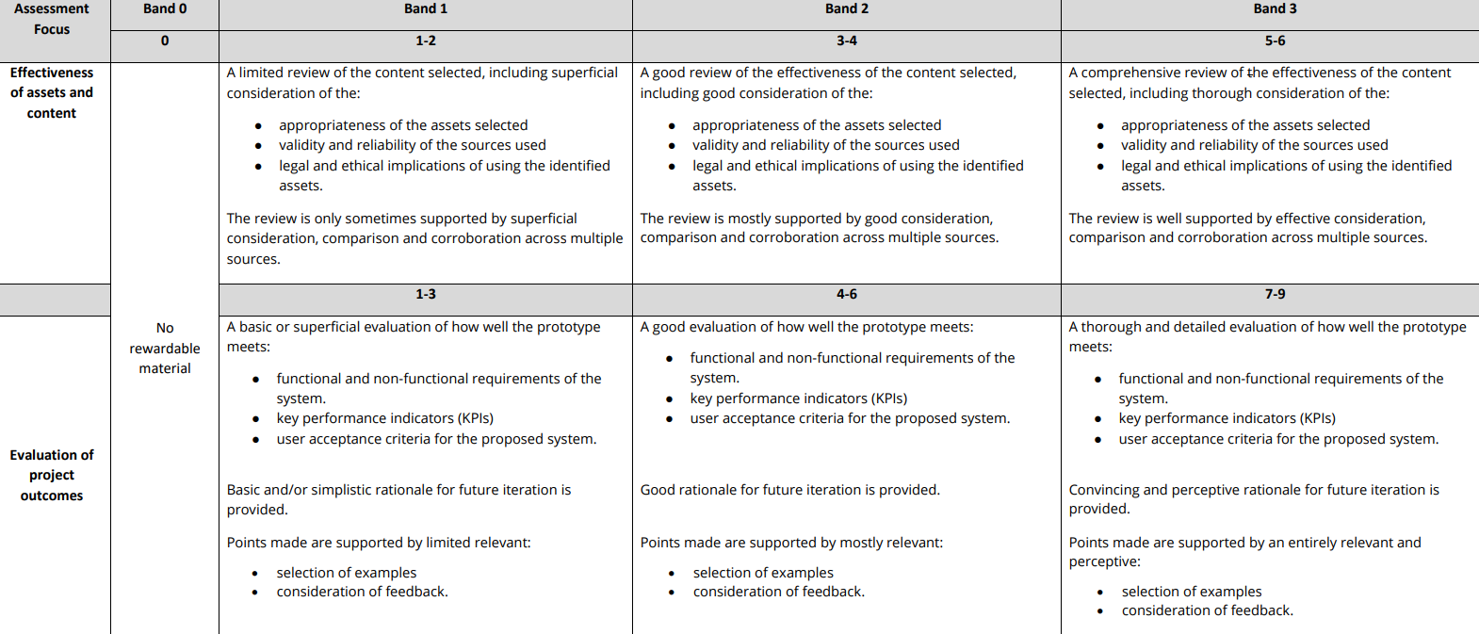
Compare with the Mark Scheme

Slide 5
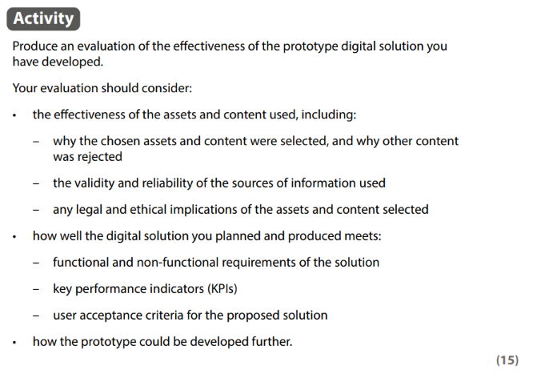
Compare with the Mark Scheme

Slide 6

What is the purpose of an Introduction?
An introduction sets the stage by providing essential background and defining the topic's significance and scope. It clearly outlines what will be examined by breaking the subject into manageable parts and considering the target audience, using accessible language and defining any ambiguous terms. Additionally, it sets the tone and engages the reader from the outset, inviting them to explore the analysis further.
The introduction should explain the significance of the topic and indicate who will benefit from or be affected by the subject matter. This might involve discussing the broader impact of the digital solution or why certain criteria are crucial in evaluating its performance.

Slide 7
How would you begin an evaluation?
Begin your Point. | Uses
The prototype demonstrates… | Use this when highlighting how a feature or asset shows evidence of meeting certain requirements.
User feedback indicates that… | Ideal for introducing insights gathered from testing or surveys, showing how feedback shapes your evaluation.
In terms of functional requirements… | Helpful for focusing specifically on whether or not the solution meets the fundamental technical needs.
With regard to non‑functional requirements… | Good for discussing aspects like usability, performance, security, or maintainability.
Legally and ethically, the solution addresses… | Use this to evaluate compliance with copyright, data protection (GDPR), or other ethical considerations.
Notes:
What do all these openings have in common?

Slide 8
FIRST SENTENCES
First Sentence
…
…
What comes first sets the tone. It must.
In an essay, the first sentence of a paragraph ought to indicate what that paragraph is about. If it does not, there is a high risk of logical confusion developing. This makes the writing less clear.
The purpose of an essay is to communicate understanding, argument and judgement. Therefore, one should always strive for clarity and sense. From the first sentence, to the last.

Slide 9

The main body
The body of an essay is the central part where the main arguments are developed. It is typically the longest section, as it needs to cover all key points that support the statement or topic. Each paragraph focuses on one idea and begins with a topic sentence that outlines its main point. Evidence and analysis are then provided to support this point, followed by a concluding sentence that ties it back to the central argument. The number of paragraphs depends on how many points are necessary to fully support the essay’s thesis.
The body of an essay is the central foundation where the writer presents the key arguments introduced in the introduction. It is typically the longest section because it must develop each controlling idea in depth. Each paragraph focuses on one main point, supported by evidence and analysis. A concluding or transitional sentence ties each paragraph back to the overarching topic. The total number of paragraphs depends on how many points are needed to validate the essay’s main argument.
Topic Sentence
Support Evidence (Sharpe, 2025) Support Support
Concluding Sentence

Slide 10
“What do you mean?” (Bieber, 2015)
Expand your Point. | Uses
This suggests… | Use when referencing user comments or survey results that highlight strengths, weaknesses, or areas for improvement.
These findings indicate… | Ideal for introducing data or statistics that reveal trends, patterns, or performance levels.
This approach demonstrates… | Helpful for discussing specific techniques or features (e.g. code snippets, design elements) and their impact on meeting requirements.
Throughout the evaluation, it becomes clear that… | A good way to summarise multiple pieces of evidence and show how they collectively support a point.
This highlights how… | Useful for emphasising a particular insight or consequence, linking evidence directly to your argument or conclusion.
Notes:
What do all these openings have in common?

Slide 11
Viewpoints
In a court case two different arguments will be proposed in the face of a single set of evidence. Instances are frequent where both cases are persuasive and plausible. It can take much careful reasoning to come to a decision as to the verdict which ought to be given.
People, eager to put forward their own viewpoints, sometimes miss the nuances inherent in many topics.

Slide 12

Why is your conclusion important?
A conclusion demonstrates that you have met the objectives set out in your introduction and provides a sense of closure. By summarising the main points from each body paragraph, it ensures a balanced and cohesive discussion. The closing sentence is crucial, as it reinforces the significance of your ideas and leaves a lasting impression on the reader. Ultimately, a strong conclusion highlights why your evaluation matters and prompts further reflection.
A conclusion is more than just a final paragraph—it is your last opportunity to demonstrate you have fulfilled your initial purpose and presented a cohesive argument. By summarising the key points from each body paragraph, you show how all parts of your discussion connect. Your closing sentences should provide a sense of closure while underscoring the importance of your ideas. Ultimately, a well-crafted conclusion leaves the reader with a lasting impression, reaffirming why your findings matte

Slide 13
How would you End an evaluation?
Expand your Point. | Uses
In conclusion, … | Use this to introduce your final summary and reaffirm the main points discussed in your evaluation.
Overall, the evidence demonstrates … | Ideal for summarising the cumulative findings and reinforcing how the collected evidence supports your central argument.
Ultimately, this analysis reveals … | Helpful for highlighting the key takeaways and linking the findings back to the objectives set out at the beginning.
It is clear that … | A strong way to connect your final insights to the evaluation criteria, leaving the reader with a definitive understanding of your conclusions.
The final assessment confirms that … | Use this to assert your final stance and ensure the reader recognises the importance and impact of your evaluative insights.
Notes:
What do all these openings have in common?

Slide 14
REASONS
If A,
Then B
If B,
Then C
If A,
Then C
We use reasons to persuade others that our claims are true.
Each of these is a reason supporting the claim (or conclusion). We could insert the word ‘because’ between them to further prove the case.

Slide 15
STRUCTURE
Introduction -> Arguments For -> Arguments Against -> Conclusion
Introduction -> 1st Argument For -> 1st Argument Against -> 2nd Argument For -> 2nd Argument Against -> Conclusion
Introduction -> Main Body -> Conclusion
Introduction -> First Key Theme -> Second Key Theme -> Third Key Theme -> Conclusion
Introduction -> First Point -> Critique of First Point -> Second Point -> Critique of Second Point -> Conclusion

Slide 16



EVALUATION OF EXAMPLE WORK
Can you open both documents
Questions to Break Down the 3b Evaluation
&
t-level-digital-OSC-Task 3b
Review the previous OSC and answer the questions on the sheet
60 Mins

Slide 17

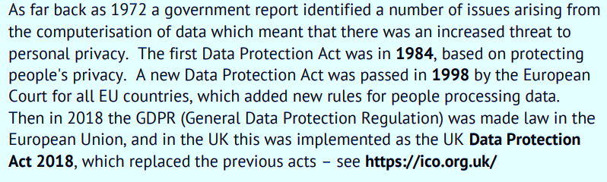
THE NEED OF THE DATA PROTECTION ACT

Slide 18

The Need of the Data Protection Act
During the second half of the 20th Century, businesses, organisations and the government began using computers to store information about their customers, clients and staff in Databases.
For Example:
Names
Addresses
Contact Information
Employment History
Medical Conditions
Convictions Credit History

Slide 19

The Need of the Data Protection Act
Databases are easily accessed, searched and edited. It’s also far easier to cross-reference information stored in two or more databases than if the records were paper-based.
The computers on which databases resided were often networked. This allowed for organisation-wide access to databases and offered an easy way to share information with other organisations.

Slide 20
The Need of the Data Protection Act
The 2018 Date Protection Act was passed by Parliament to control the way information is handled and to give legal rights to people who have information stored about them.
Other European Union countries have passed similar laws as often information is held in more than one country.

Slide 21
The Need of the Data Protection Act
If you hold data about someone else (the data subject) you are a data controller, and if you are storing, using processing data belonging to another organisation then you are a data processor and must have a formal DPA (data processing agreement) with the data controller.

Slide 22


Case Study
TalkTalk, a telecommunications provider, suffered a major data breach in 2015. How were many customers’ details where stolen? How much ICO get fined? How much did this cost the company? How did it affect the company?
10 minutes
Notes:
TalkTalk, a telecommunications provider, suffered a major data breach in 2015. How many customers’ details were stolen? 157,000 How much ICO get fined? £400,000 How much did this cost the company? £80,000,000

Slide 23

Afterwards
The share price of TalkTalk dropped by 11% at the time. But we will never know how many customers have left or been discouraged from using TalkTalk as a provider.

Slide 24
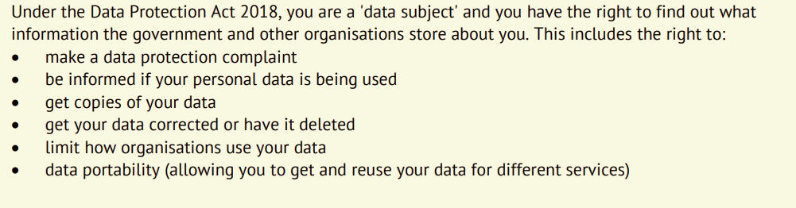

How does it affect me?

Slide 25
Have you given permission for your data to be?

Slide 26
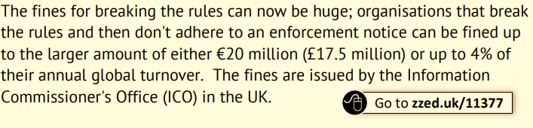

Fines for breaking the rules

Slide 27

Creating an Evaluation Checklist
Develop a checklist that you can use when writing your evaluations.
The checklist should include:
Clear introduction stating context and objectives.
Detailed evidence in the body with references to project outcomes, tester feedback, and legal/ethical considerations.
A conclusion that summarises findings and suggests future development.

